Slide 1
Weather Wear!
An innovative AI solution to everyday weather

Slide 2

Cloudy problems in a Cloud Ara
Using innovate AI technology alongside existing weather forecasting technology, we can push forecasting into the modern era!
Providing the perfect outfit suggestions for the days weather

Slide 3
The Process
Front-end
Python Flask is running, in the aws instances to provide a front end. Our code is integration friend to any major weather website
Weather-API
Weather - API integration into the code provides us with real time weather data
AI
Providing AI the weather data, and some clever AI Engineering. We can provide the ideal outfits for the day

Slide 4
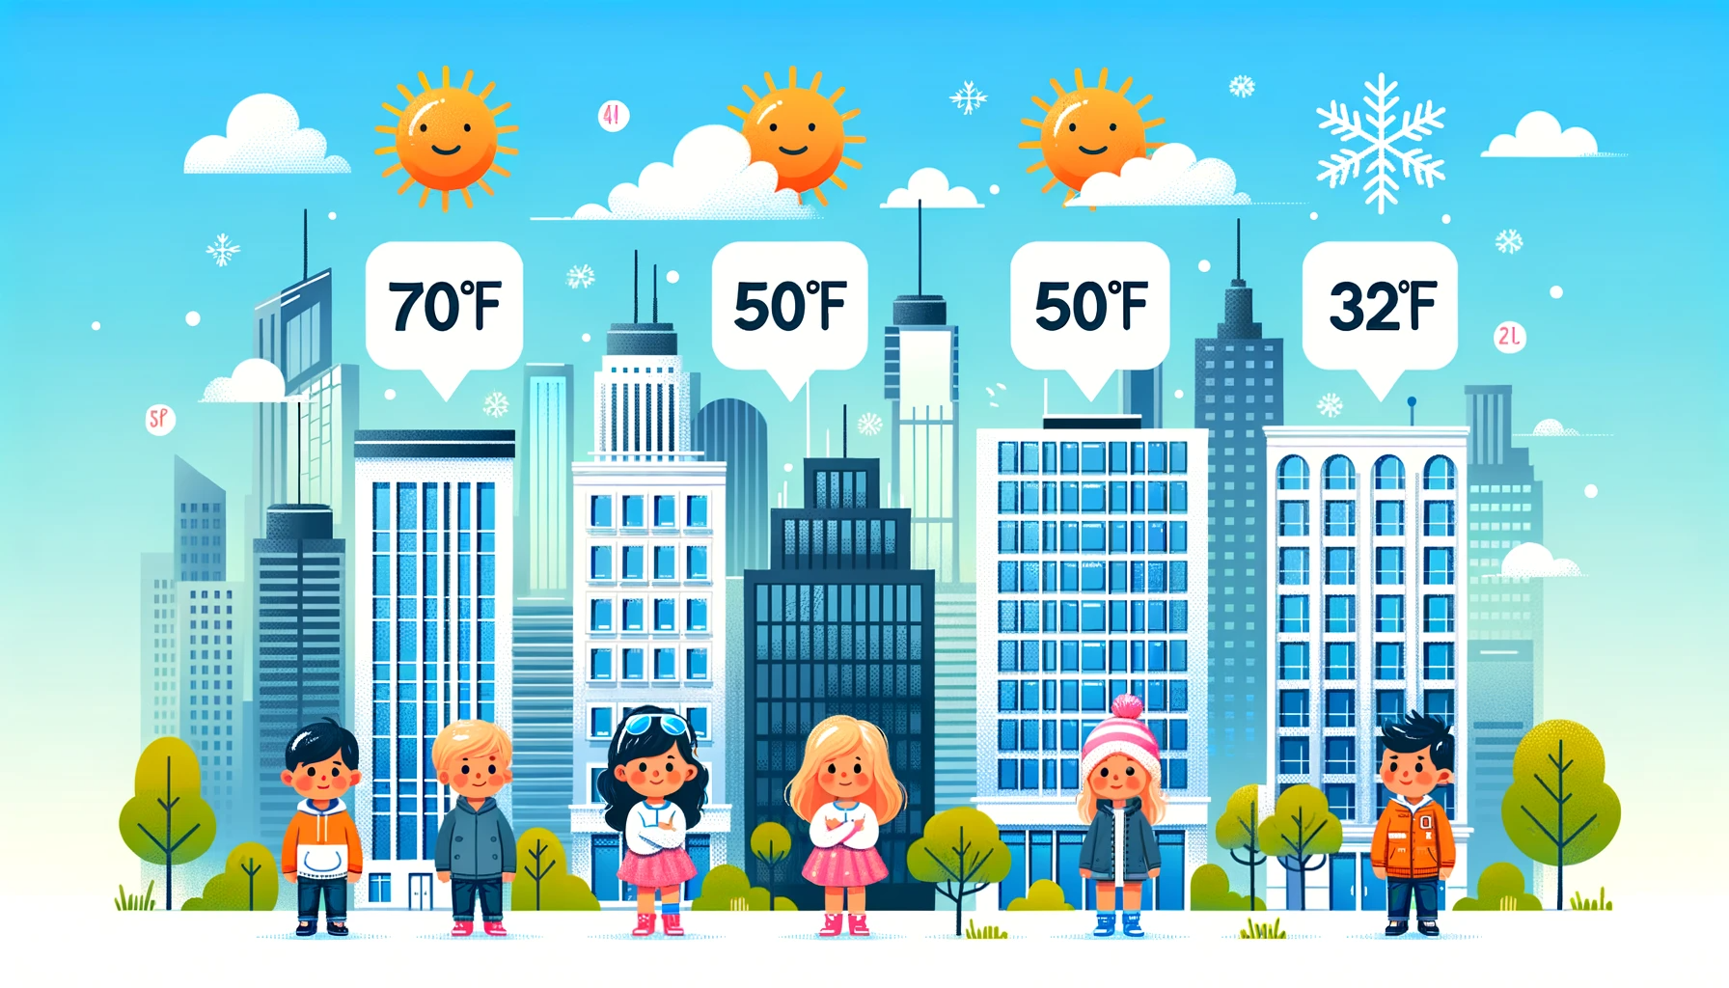
Demo!

Slide 5

Future Features
Use stability diffusion XL, to generate sample photo of the weather and recommended outfits
Including increased time granularity for the clothing suggestions.
At 4 pm - you will no longer need your jacket
An additional prompt to personalized outfit suggestions
Using device location to prefill the location field

